Slide 1
DAT 205 Capstone
Preparing PowerPoint Presentations

Slide 2
Purpose of a Presentation
Is not to
Impress the audience
Tell them all you know about a subject
Present every little detail of your work
Is to
Give the audience a clear picture of what your findings are
Give them actionable information
Provide evidence for decision making

Slide 3
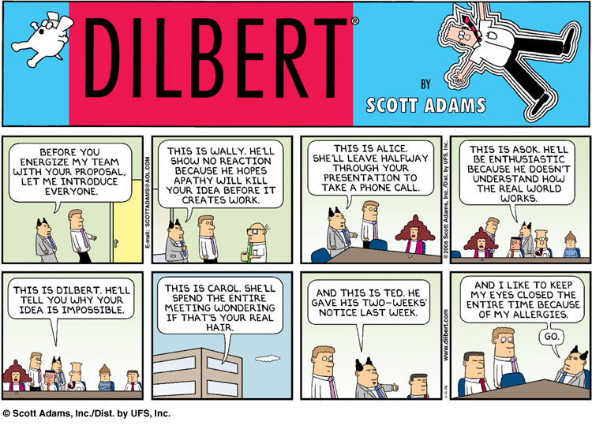
Know your audience

Slide 4
Know Your Audience
Long Term
Short Term
Executive C-Suite
Management
Operations
High Level
Strategic
KISS
Mid Level
Fairly Complex
Tacticall
Detail Oriented
Day to Day
“Process Feeding”

Slide 5
Know your audience
Keep in mind
They might be tired
They can read ☺
They are thinking “Why should I listen?”
Non-experts will tune off within 2 minutes
Experts after 5 minutes
What can you do?

Slide 6
What can you do?
Early motivation - at the beginning of your talk motivate your research with easy to understand examples
Spoil the punch line - State your results early and in simple terms
Visuals – Illustrate your idea with images and diagrams

Slide 7
Leave the audience with these thoughts
I understand what the problem was and why it was important
I have an idea of what the potential solutions/opportunities are
She is very competent, and I have confidence in the information she has presented

Slide 8
Use examples
Examples are your weapon to:
Motivate your work
Illustrate the basic intuition
Show your solution in action (baby problem)
Highlight extreme cases or shortcomings

Slide 9
Where were you?
People will get lost during your talk, even those who are listening
have a running outline of the main steps of your idea (more than the talk itself)
use visual clue to highlight where you are in the process
present it at the beginning of each step

Slide 10
Related work
Be familiar with all related or previous projects
Talk about results that are directly related to the objectives
References at the end of the talk or better in the report itself
Acknowledge colleagues (title slide)

Slide 11
Technical details: in or out?
A fine line
Present specific aspects that show the “meat” of your work
Leave the rest out or put it in an appendix.
Don’t fill up your slides with lots of data
Prepare back-up slides to answer questions. Leave them at the end of the presentation

Slide 12
The skeleton
What is the problem/opportunity?
Objectives and goals
What are the key takeaways
What are the next steps

Slide 13
Preparing the presentation
Less is more. Fill in with narration not words
Use animation sparingly
Use color to emphasize some points
Be consistent! Layouts, fonts, etc.
Use slide real estate appropriately
White space

Slide 14
Slide layout - Bad
This page contains too many words for a presentation slide. It is not written in point form, making it difficult both for your audience to read and for you to present each point. Although there are exactly the same number of points on this slide as the previous slide, it looks much more complicated. In short, your audience will spend too much time trying to read this paragraph instead of listening to you.

Slide 15
Slide layout – Good
Show one point at a time:
Will help audience concentrate on what you are saying
Will prevent audience from reading ahead
Will help you keep your presentation focused

Slide 16
Fonts - Good
Use a decent font size
Use different size fonts for main points and secondary points
this font is 22-point, the main point font is 28-point, and the title font is 44-point
Use a standard font, nothing strange

Slide 17
Fonts - Bad
If you use a small font, your audience won’t be able to read what you have written
CAPITALIZE ONLY WHEN NECESSARY. IT IS DIFFICULT TO READ
Don’t use a complicated font

Slide 18
Color - Good
Use font color that contrasts sharply with the background
Blue font on white background
Use color to reinforce the logic of your structure
Ex: light blue title and dark blue text
Use color to emphasize a point
But only use this occasionally

Slide 19
Color - Bad
Using a font color that does not contrast with the background color is hard to read
Using color for decoration is distracting and annoying.
Using a different color for each point is unnecessary
Same for secondary points
Trying to be creative can also be bad

Slide 20
Background - Good
Use backgrounds such as this one that are attractive but simple
Use backgrounds which are light
Use the same background consistently throughout your presentation

Slide 21
Background – Bad
Avoid backgrounds that are distracting or difficult to read from
Always be consistent with the background that you use

Slide 22
Graphs - Good
Use graphs rather than just charts and words
Data in graphs is easier to comprehend & retain than is raw data
Trends are easier to visualize in graph form
Always title your graphs

Slide 23
Graphs - Bad

Slide 24
Graphs - Good

Slide 25
Graphs - Bad

Slide 26
Graphs - Bad
Minor gridlines are unnecessary
Font is too small
Colors are illogical
Title is missing
Shading is distracting

Slide 27
Preparing the presentation
Prepare the slides in advance
Show them to peers/colleagues
Read and edit several times
Check all animations (if you use them)

Slide 28
Preparing the presentation
Practice, practice, practice
Give a practice talk to a general audience
Give a practice talk to an audience of experts
Time your presentation (allow for speed up effect caused by nervousness)
Always assume technology will fail you. Have backups.

Slide 29
Delivering the talk
Show your interest
Make eye contact with the audience
Engage the whole room
Watch for questions. Be prepare to digress or brush off when irrelevant

Slide 30
Delivering the talk
Point at the screen not the computer
Do not read directly from the PPT or your notes
Have the “spill” for the first couple of slides memorized in case you go blank
Finish on time

Slide 31
Handling questions
Different types – handle accordingly
Need clarification
Suggest something helpful
Want to engage in research dialog
Show that he/she is better than you
Anticipate questions (additional slides)
Don’t let them highjack the talk (postpone)

Slide 32
How can I get better?
Practice every chance you can
Observe others
Steal good presentation ideas
Notice all the things that turned you off
Seek comments from friends and mentors

Slide 33
Preparing PowerPoint Presentations Part 2
BDA 106 Capstone

Slide 34
Agenda
The Power of Storytelling
PowerPoint Suggestions
Visualising Data
Jim’s Favourite Infographics

Slide 35
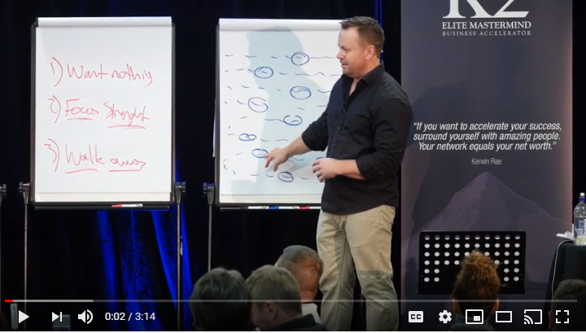
The Power of Storytelling
https://youtu.be/NM8GKlSVQTY

Slide 36
PowerPoint Suggestions
As we discussed last time, PowerPoint is a very useful tool, but there can be many pitfalls
The following are suggestions and ideas that will help you to make the most of your presentations

Slide 37
PowerPoint Suggestions
Develop your ‘story’
Introduce the topic
Explain your objectives
Develop your line of reasoning
Show your proofs
State your conclusions
Then start building your slides

Slide 38
Consistency
Maintain a consistent look and feel throughout the presentation
Don’t vary the fonts or the font size too much
Don’t use colour (or multiple colours) too much
All the stuff we talked about last time

Slide 39
Cue Transitions
Be consistent, but not monotonous
If you’re changing topics, a transition slide will help you and your audience stay on track
Pause, and give them a chance to prepare for the next thing, and absorb what they’ve heard
Use a visual cue if possible

Slide 40

A New Topic
Or section of the presentation

Slide 41
Use Text Carefully
As little as reasonably possible
Lots of white space
Don’t let the audience read too much
Reveal one line at a time if you must have a text heavy slide

Slide 42
Remember last time?
This page contains too many words for a presentation slide. It is not written in point form, making it difficult both for your audience to read and for you to present each point. Although there are exactly the same number of points on this slide as the previous slide, it looks much more complicated. In short, your audience will spend too much time trying to read this paragraph instead of listening to you.

Slide 43


Images
Images can help express an idea
It has to fit the flow and style of the narrative

Slide 44
Careful of the Builds and Animations
Builds can be effective in some cases, but don’t overuse them
Animations can be distracting
Don’t mix styles or timing

Slide 45
Focus on the Important Stuff
Highlight key words or elements
Make it easy for the audience to ‘get the gist’
Use graphics to focus

Slide 46
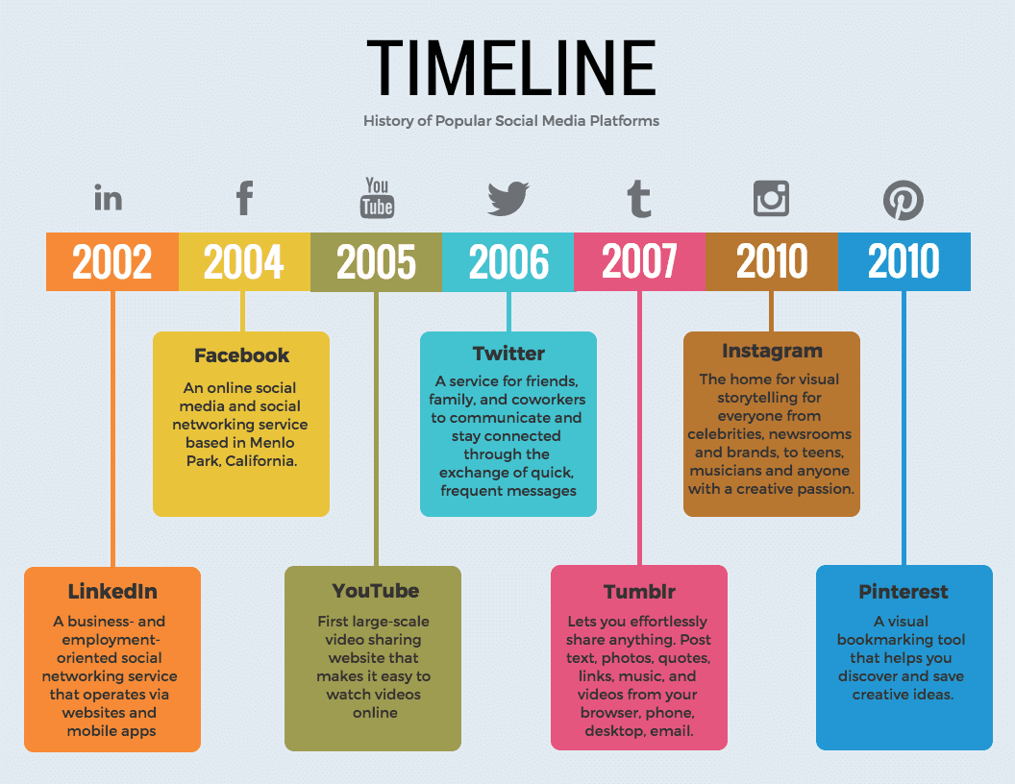

Use of Graphics

Slide 47
Charts and Graphs
Simple is better
If the topic is complex, use a series rather than one confusing graph
Avoid tables of data in most cases
Label effectively

Slide 48
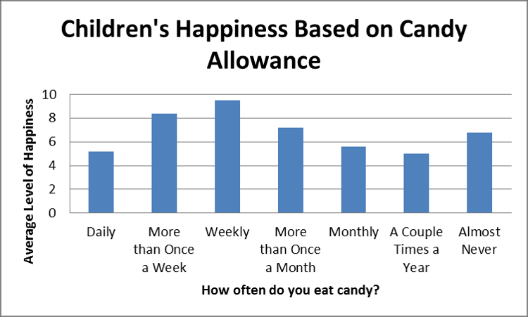
Charts and Graphs
Individual data clearly labeled
Axes clearly labeled
Clean fonts

Slide 49
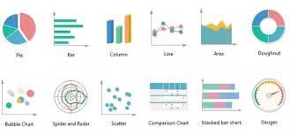
Different Types for Different Purposes

Slide 50
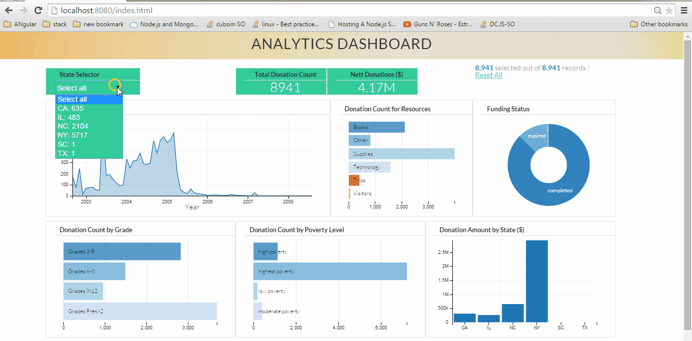
Outputs -Dashboards

Slide 51
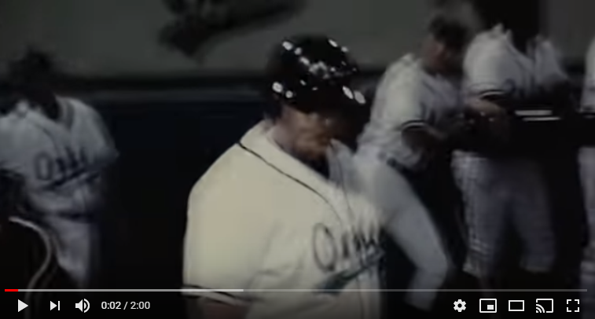
Power Of Storytelling
https://www.youtube.com/watch?v=xn7C6jgl0RI

Slide 52
Jim’s Favourite Infographics
These are well executed, creative visual displays of data that I have collected over time
Some are new; others are over 150 years old
Creativity, not technology is the key

Slide 53
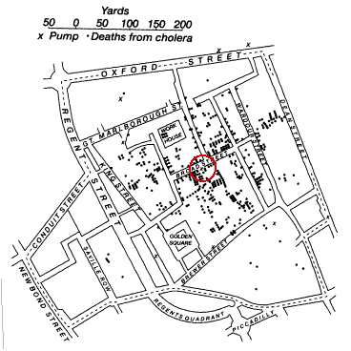
Cholera in London- Dr. Snow 1854

Slide 54
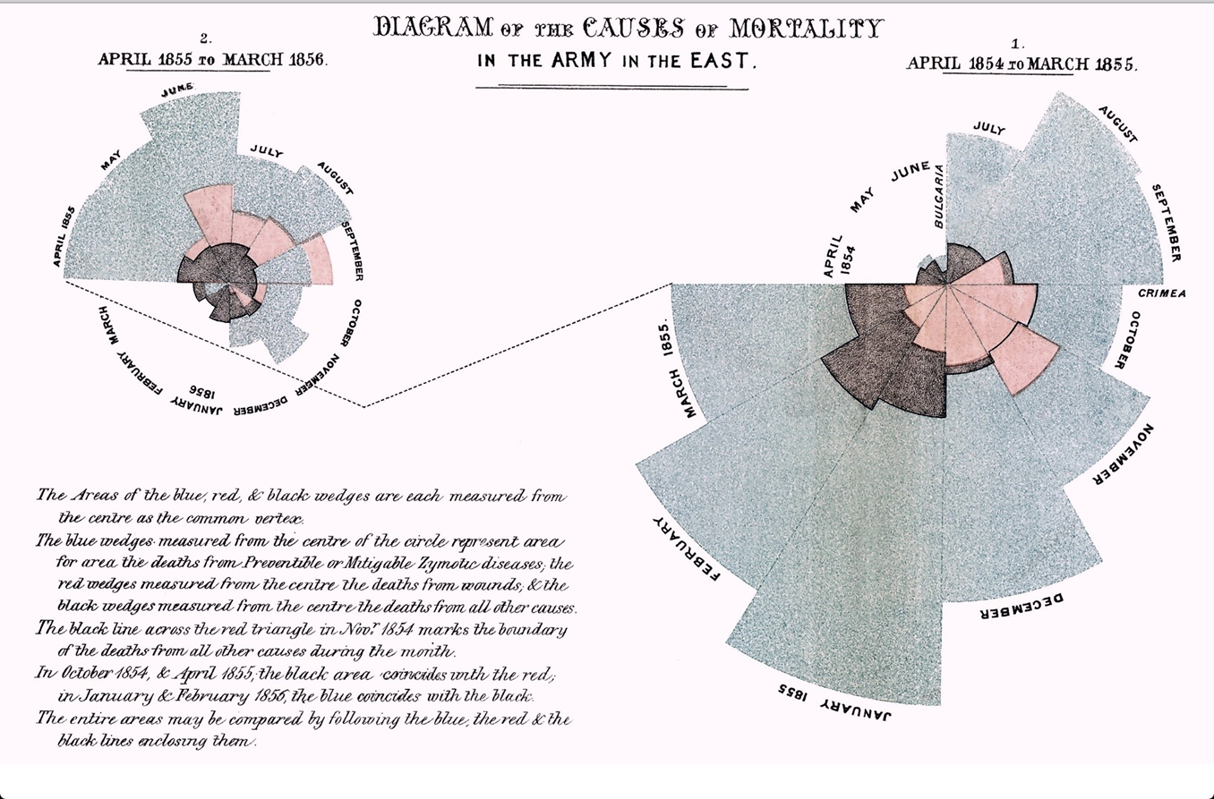
British Army – Crimean War 1856

Slide 55
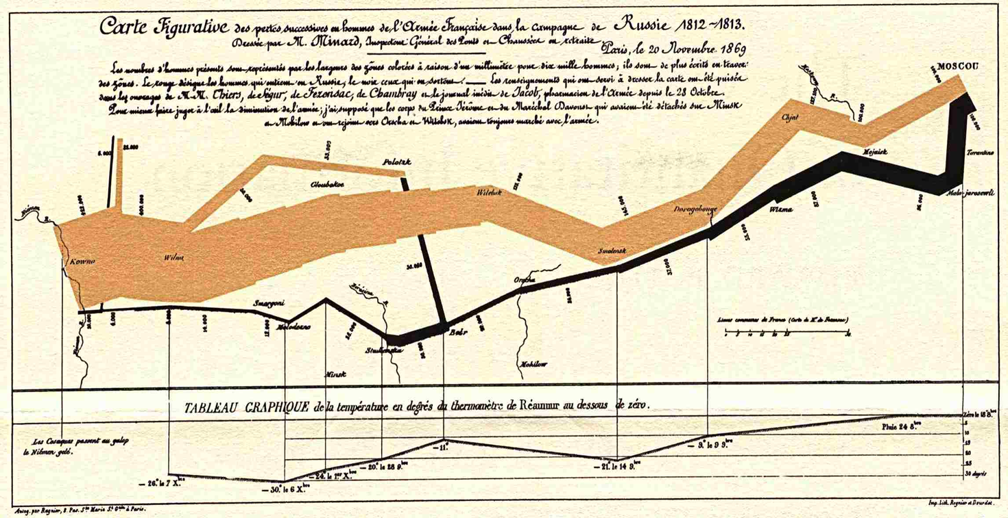
Napoleon’s March to Moscow

Slide 56

Halifax- Profile

Slide 57
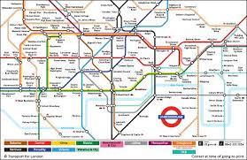
London Tube

Slide 58
Next Week

